Slide 1
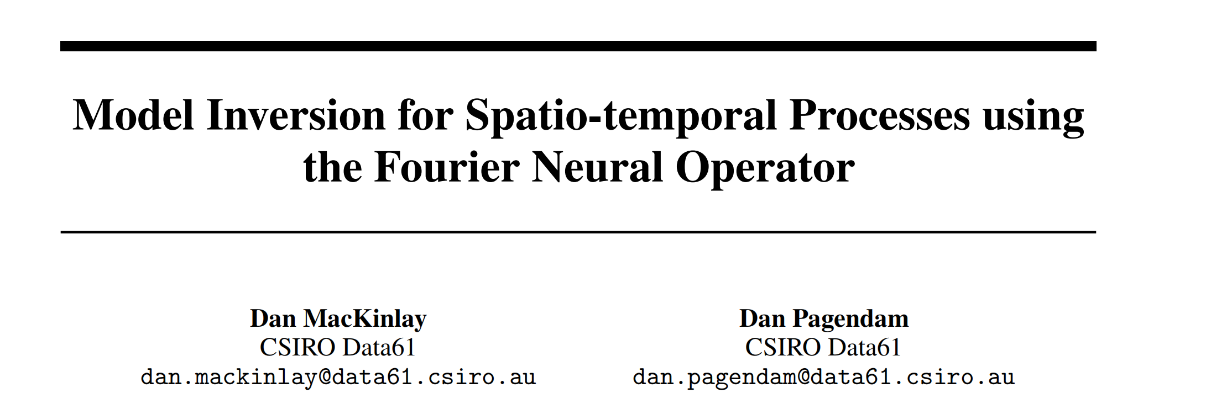
Model Inversion for Spatio-temporal Processes using the Fourier Neural Operator

Slide 2
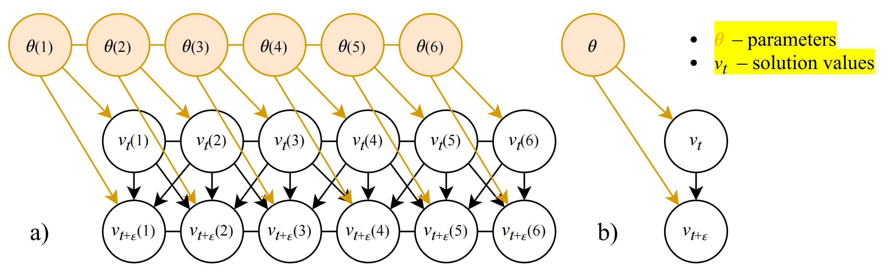
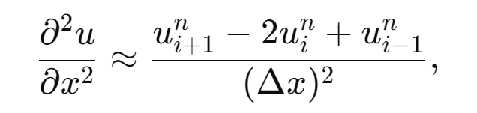
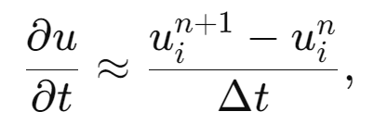
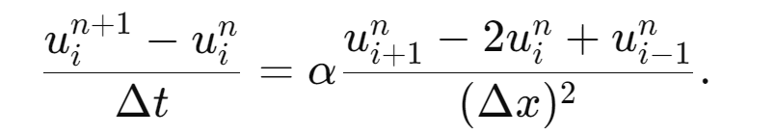
Research Background
Classical solution methods for a PDE might involve approximating some continuous domain process into a discrete approximation with complex dependency structure.
偏微分方程的经典解方法可能涉及将一些连续域过程近似为具有复杂依赖结构的离散近似。
the solution of a discretized PDE solver
The solution of continuous operator

Slide 3
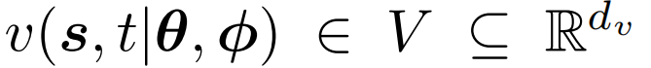
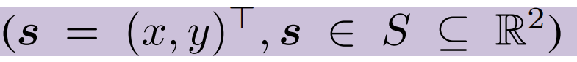

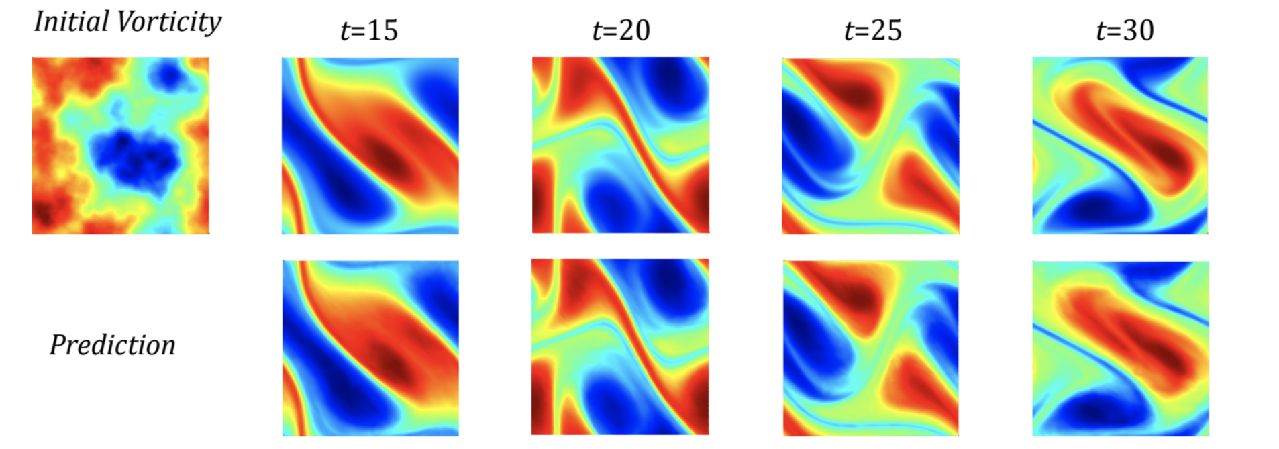
Main Method
Consider a PDE, with parameters θ, that describes the evolution of some vector-valued field,
encodes physical properties of the spatial environment
boundary conditions and/or initial conditions

Slide 4
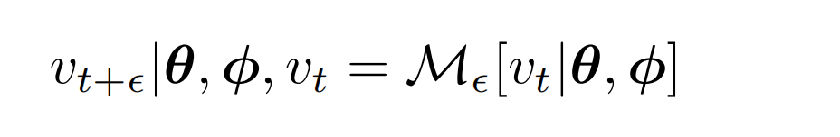
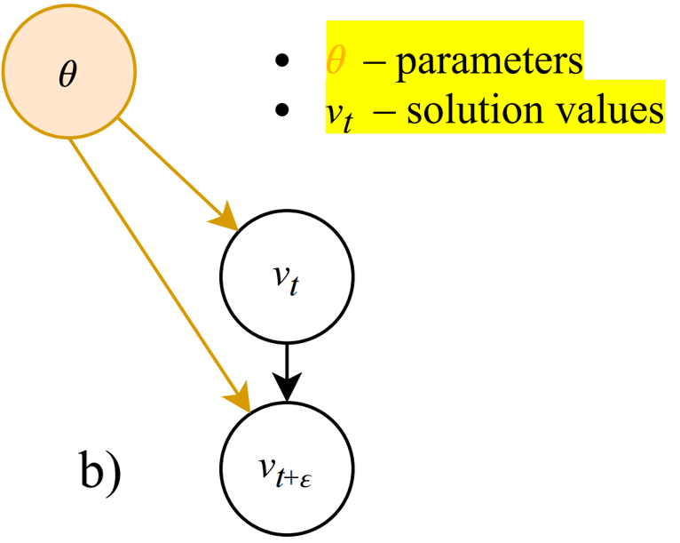
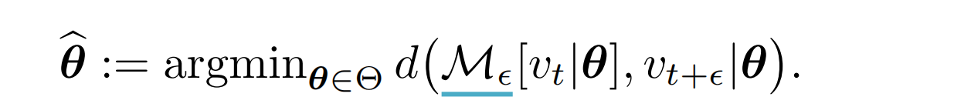
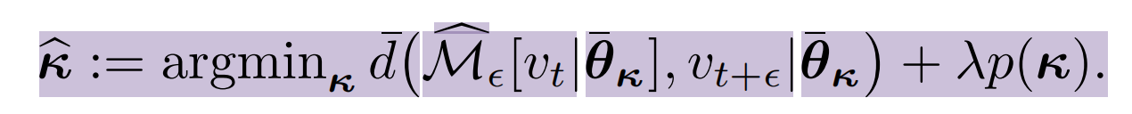
Inverse Problem Setting
PDE forward operator:
given the current state and boundary conditions and parameters
How to calculate temporal derivatives?
Inverse problem by forward operator:
A realisable inference procedure involves additional approximations; we represent θ by some finite parametrization:
the true PDE operator
The emulation
of PDE Solver
Penalty term

Slide 5
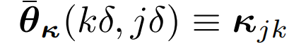
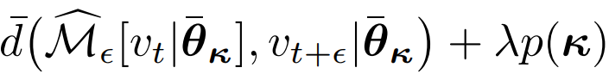
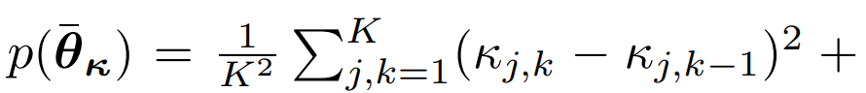
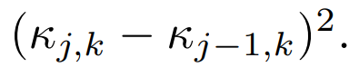
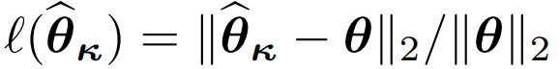
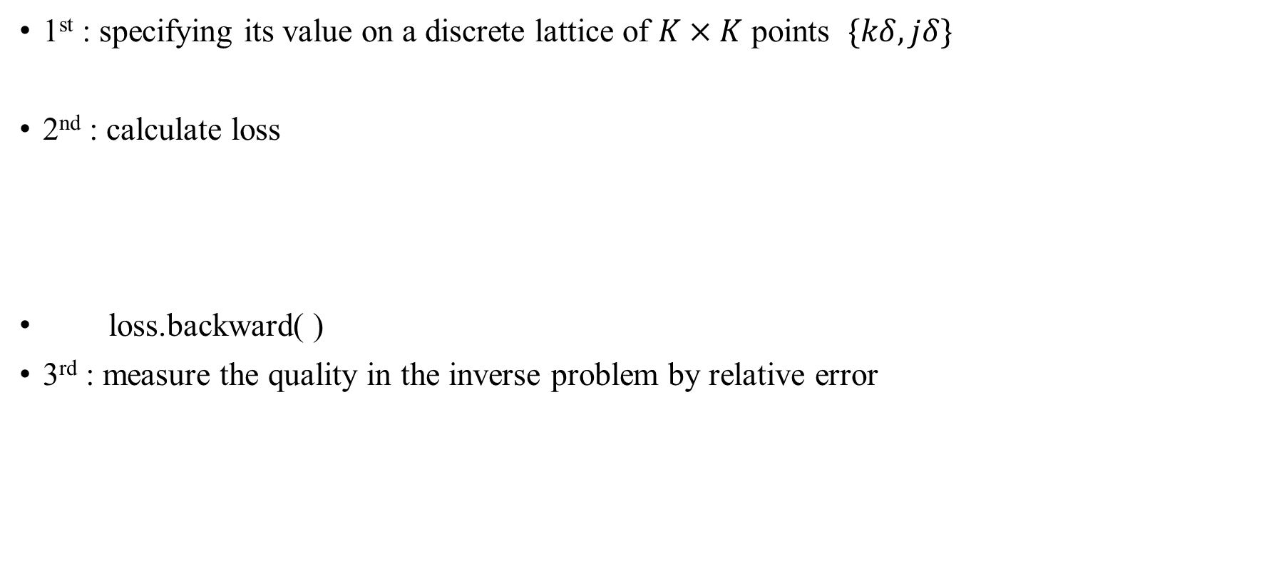
Algorithm for inverse problem
1st : specifying its value on a discrete lattice of $K×K$ points $\{kδ, jδ\}$
2nd : calculate loss
loss.backward( )
3rd : measure the quality in the inverse problem by relative error

Slide 6
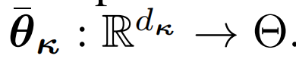
Inverse Problem Setting
A realisable inference procedure involves additional approximations; we represent θ by some finite parametrization:
the true PDE operator
The emulation
of PDE Solver
Penalty term

Slide 7
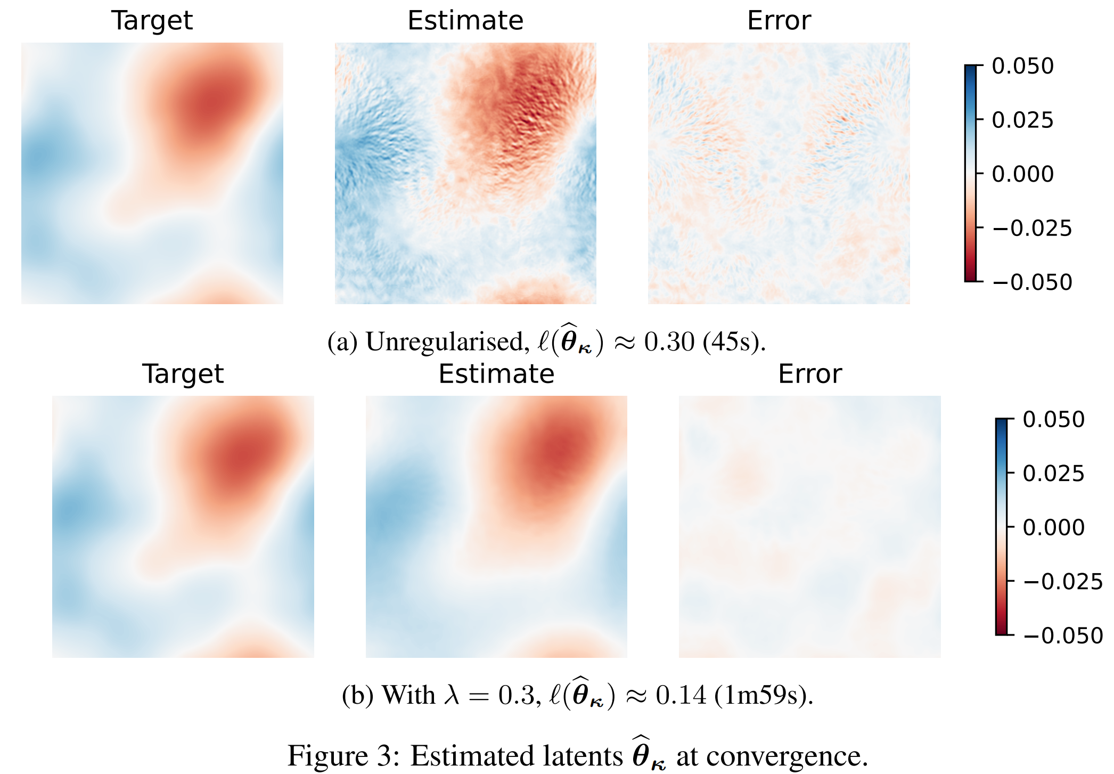
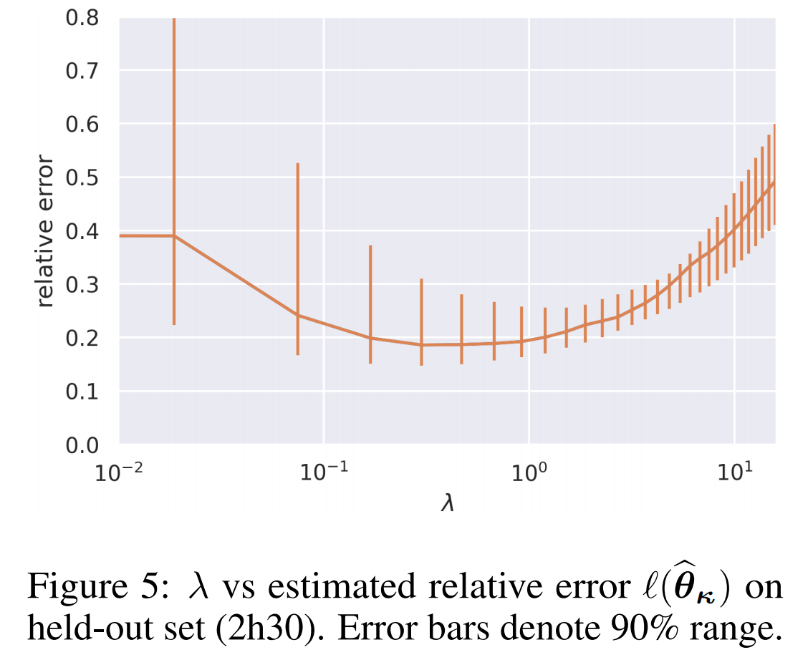
Experiment Results
1000 training
200 of each validation and testing
(256 × 256) grid

Slide 8
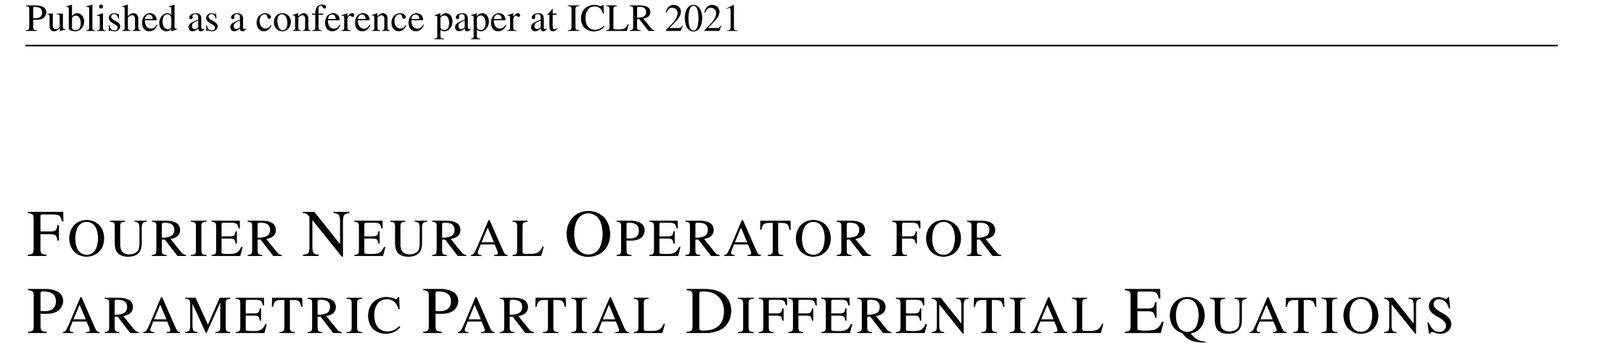
FOURIER NEURAL OPERATOR FOR PARAMETRIC PARTIAL DIFFERENTIAL EQUATIONS

Slide 9
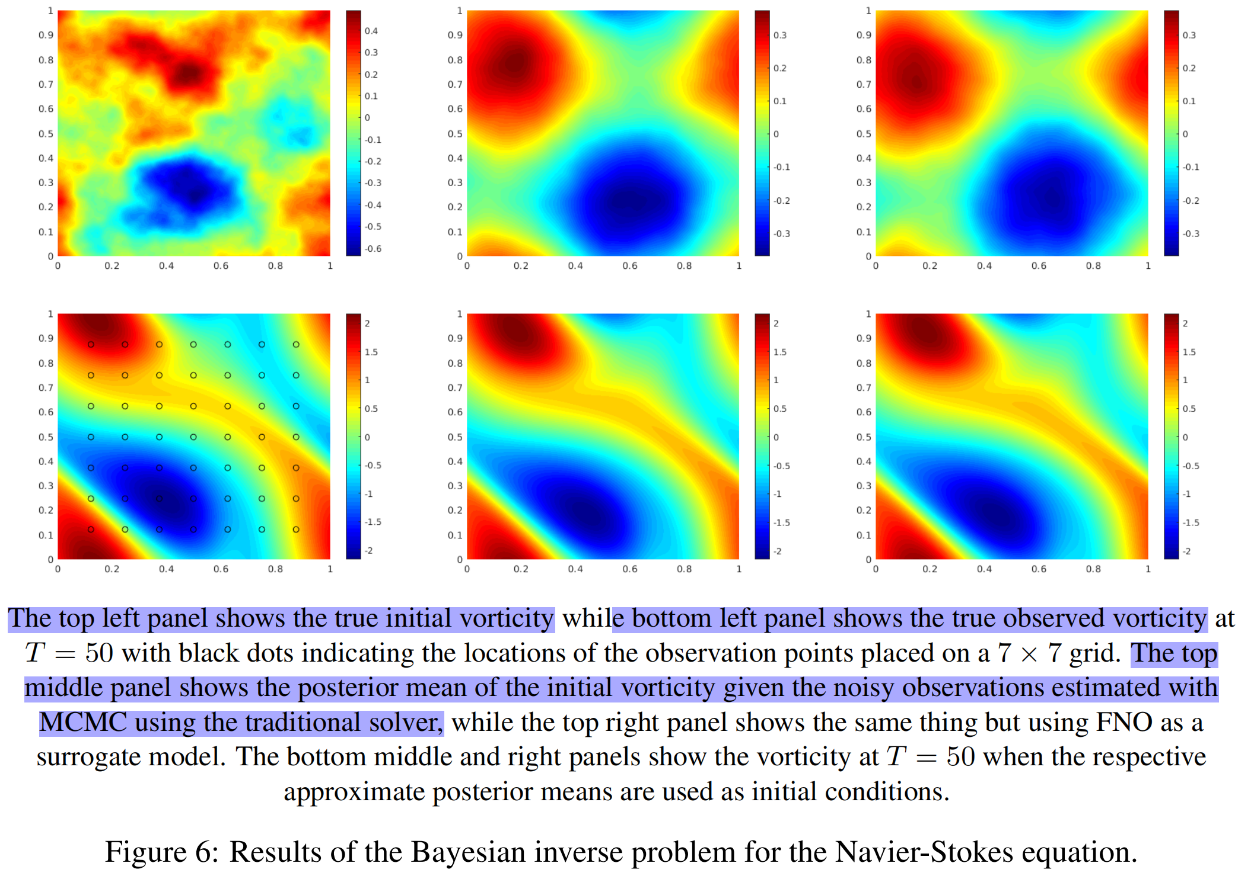
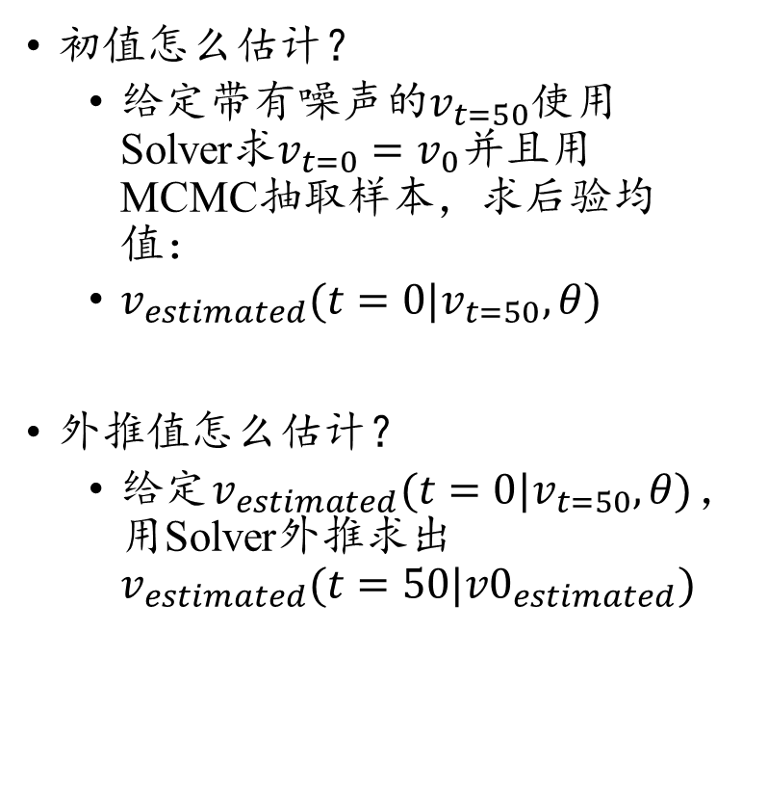
BAYESIAN INVERSE PROBLEM
初值怎么估计？
给定带有噪声的$v_{t=50}$使用Solver求$v_{t=0}=v_{0}并且$用MCMC抽取样本，求后验均值：
$v_{estimated}(t=0|v_{t=50},θ)$
外推值怎么估计？
给定$v_{estimated}(t=0|v_{t=50},θ)$，用Solver外推求出$v_{estimated}(t=50|{v0}_{estimated})$
初值
T=50

Slide 10
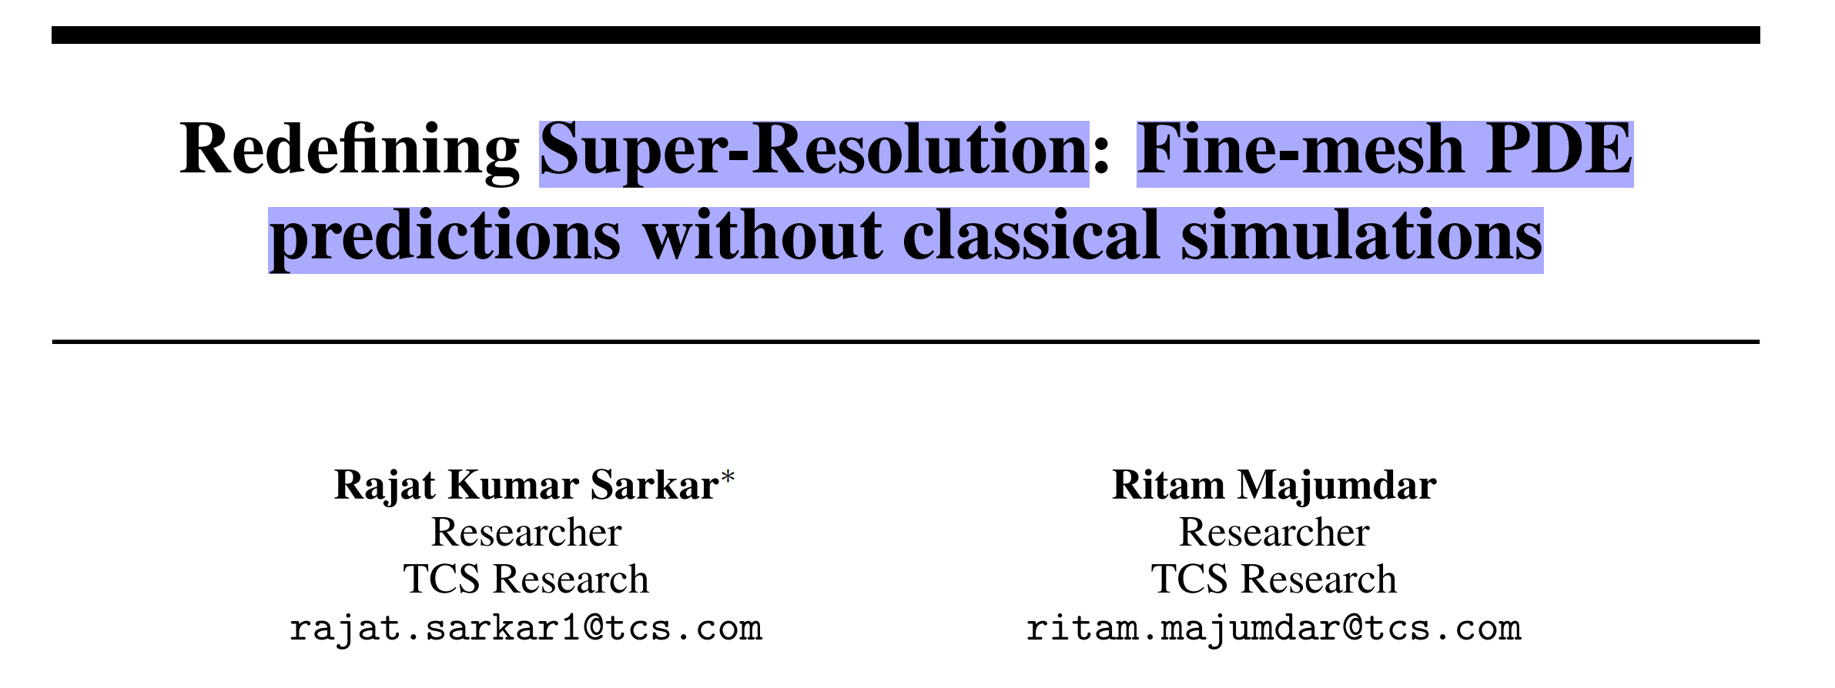
Redefining Super-Resolution: Fine-mesh PDE predictions without classical simulations

Slide 11
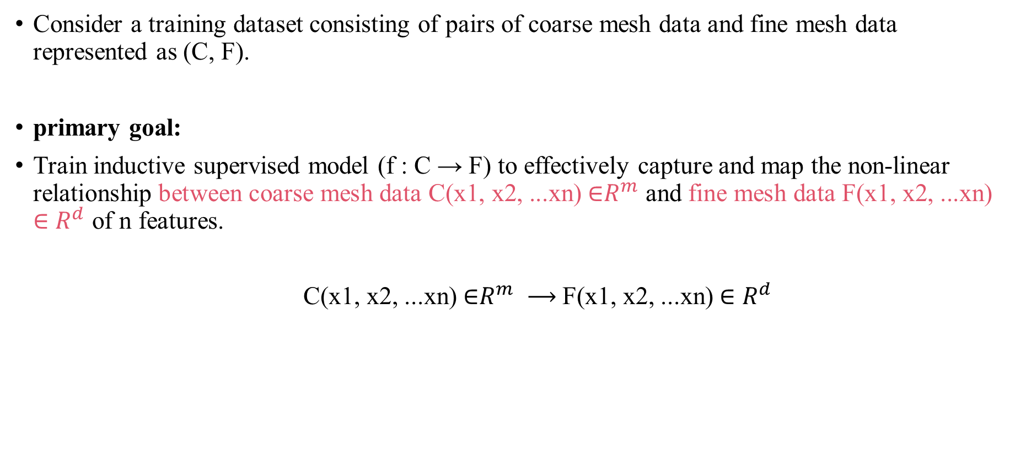
Problem formulation
Consider a training dataset consisting of pairs of coarse mesh data and fine mesh data represented as (C, F).
primary goal:
Train inductive supervised model (f : C → F) to effectively capture and map the non-linear relationship between coarse mesh data C(x1, x2, ...xn) ∈$R^{m}$ and fine mesh data F(x1, x2, ...xn) ∈ $R^{d}$ of n features.
C(x1, x2, ...xn) ∈$R^{m} ⟶$F(x1, x2, ...xn) ∈ $R^{d}$

Slide 12
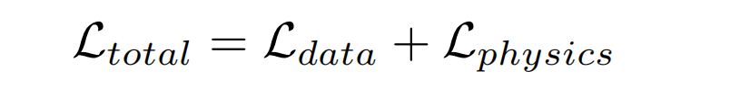
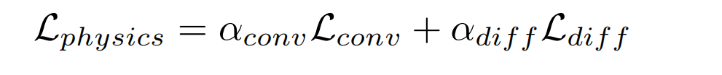
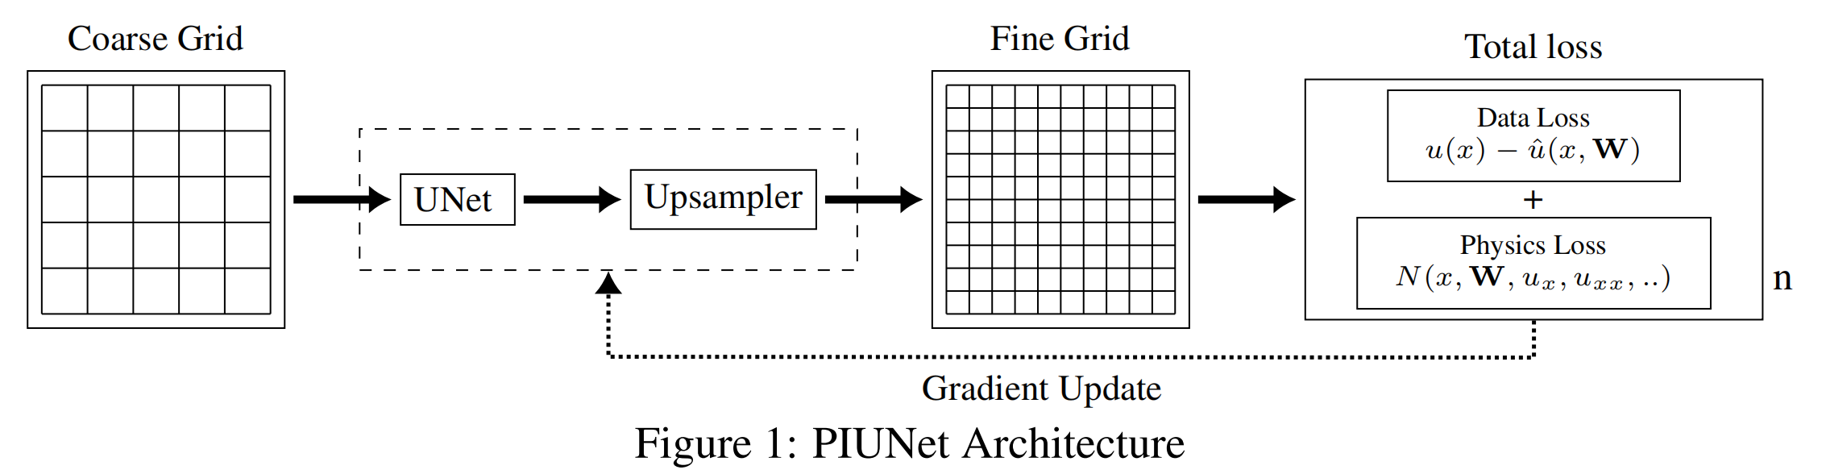
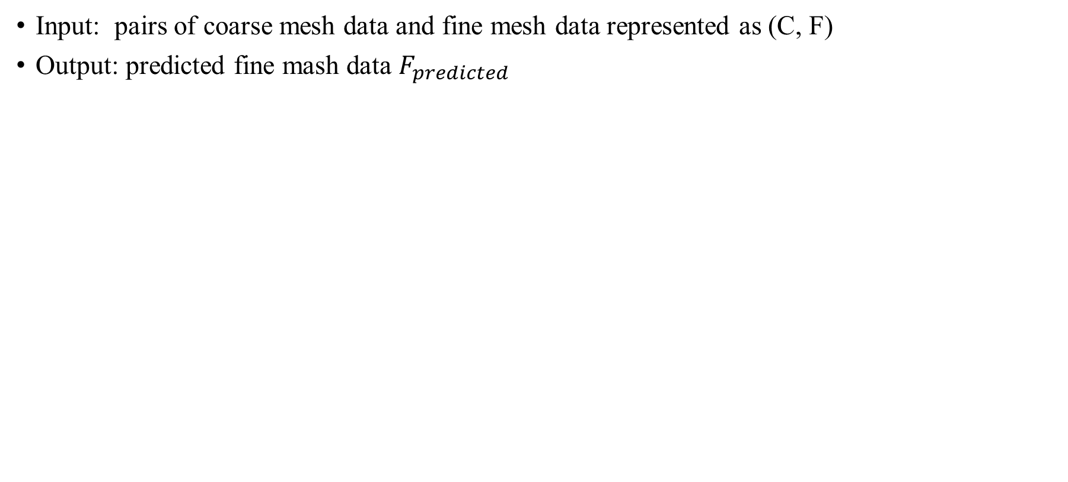
Pipeline
Input: pairs of coarse mesh data and fine mesh data represented as (C, F)
Output: predicted fine mash data $F_{predicted}$

Slide 13
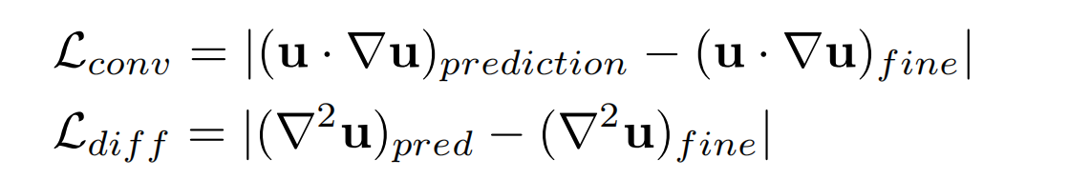
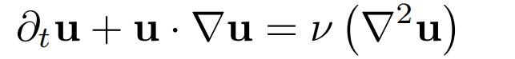
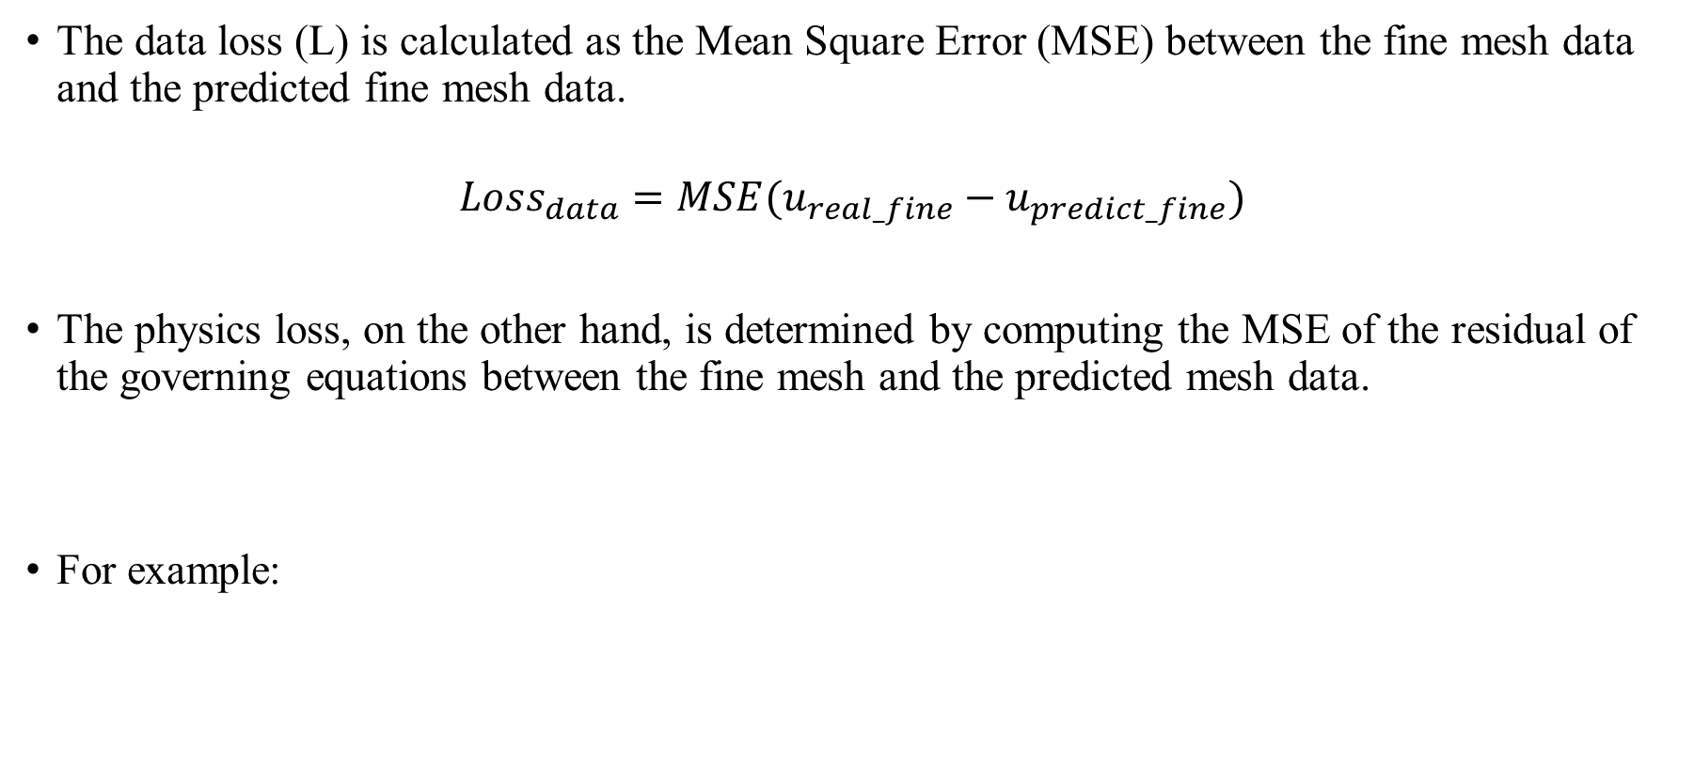
Pipeline
The data loss (L) is calculated as the Mean Square Error (MSE) between the fine mesh data and the predicted fine mesh data.
$$Loss_{data}=MSE(u_{real_fine}−u_{predict_fine})$$
The physics loss, on the other hand, is determined by computing the MSE of the residual of the governing equations between the fine mesh and the predicted mesh data.
For example:

Slide 14
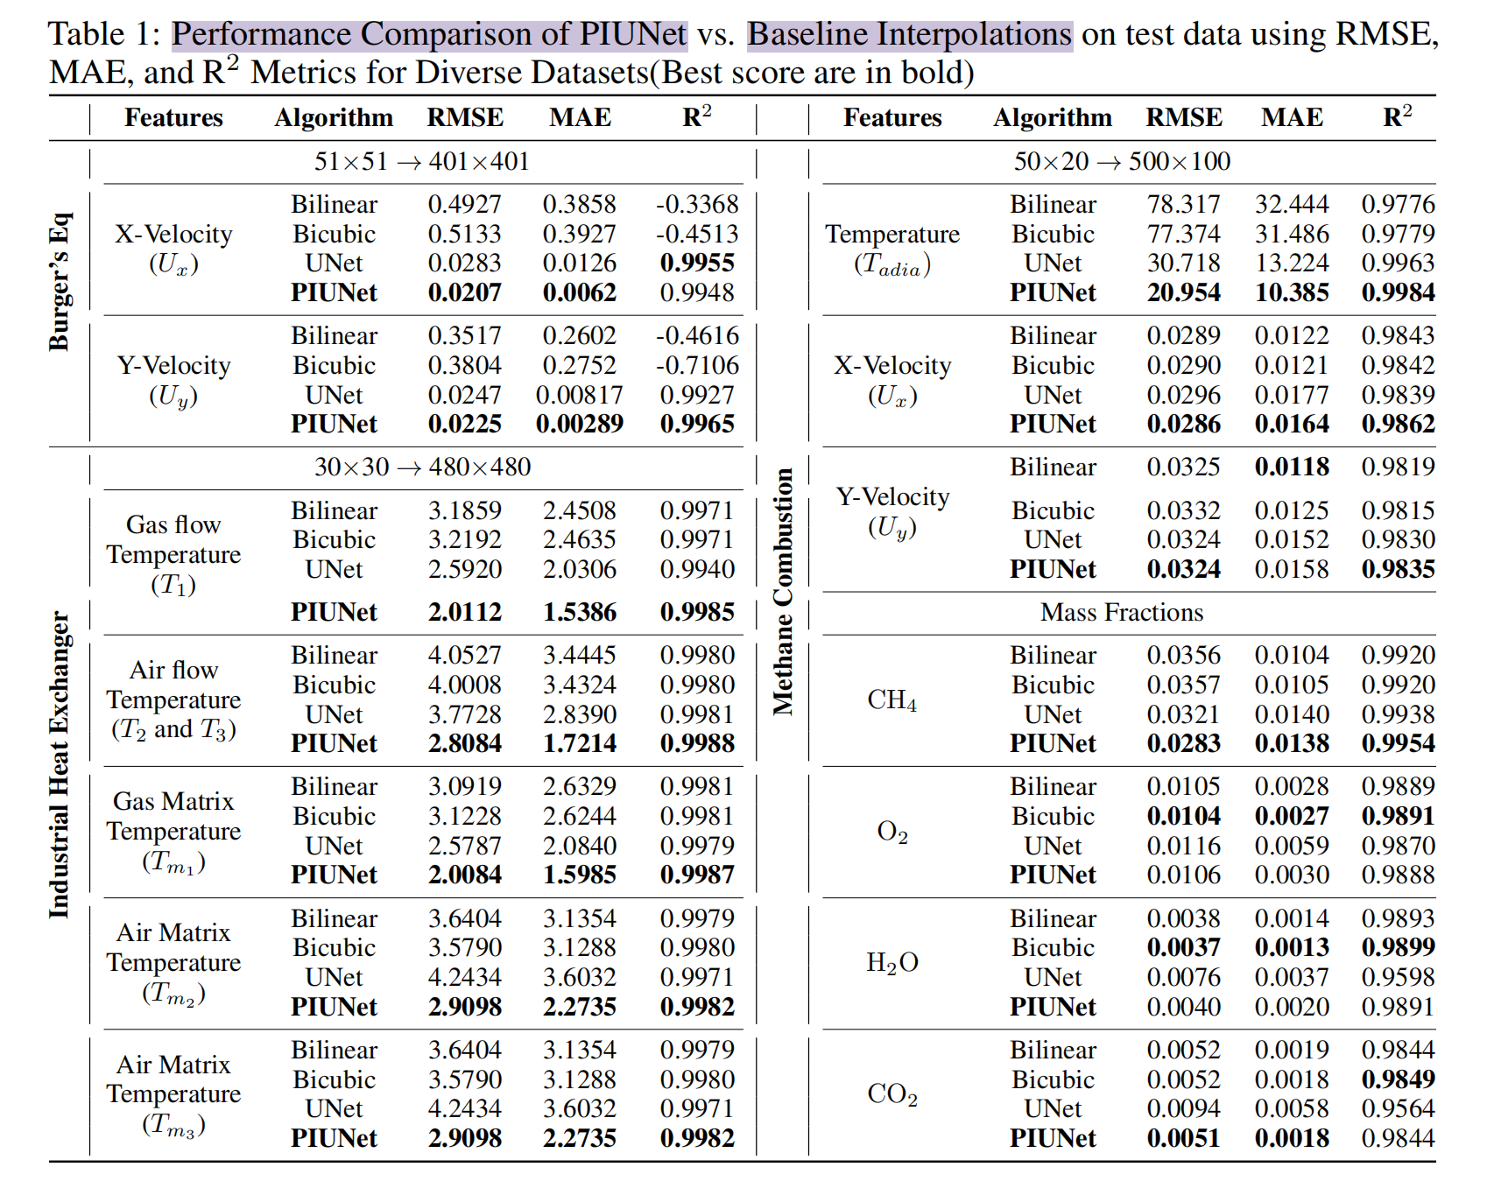
Performance

Slide 15
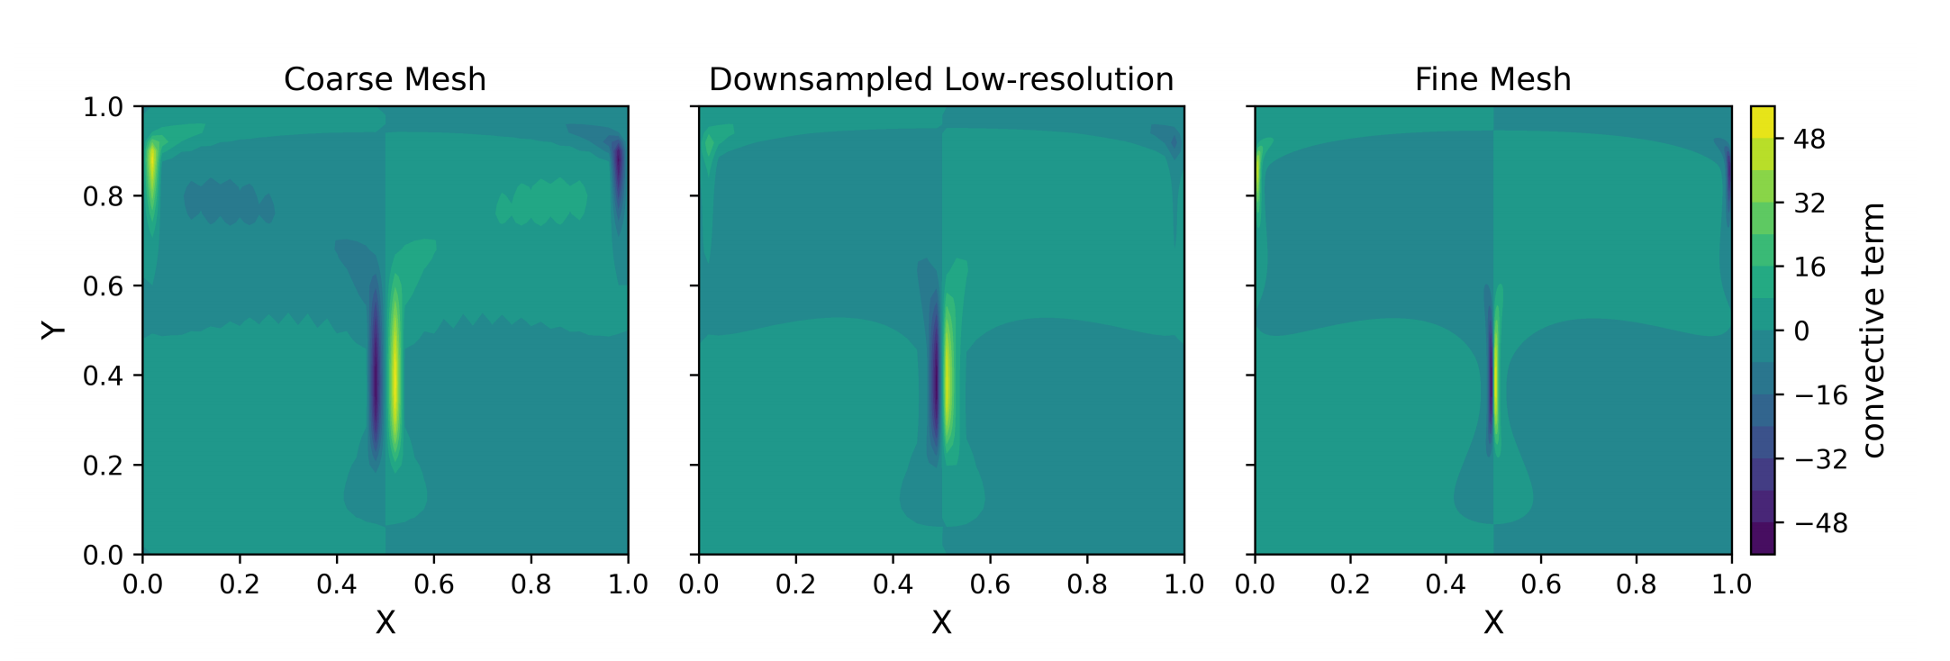
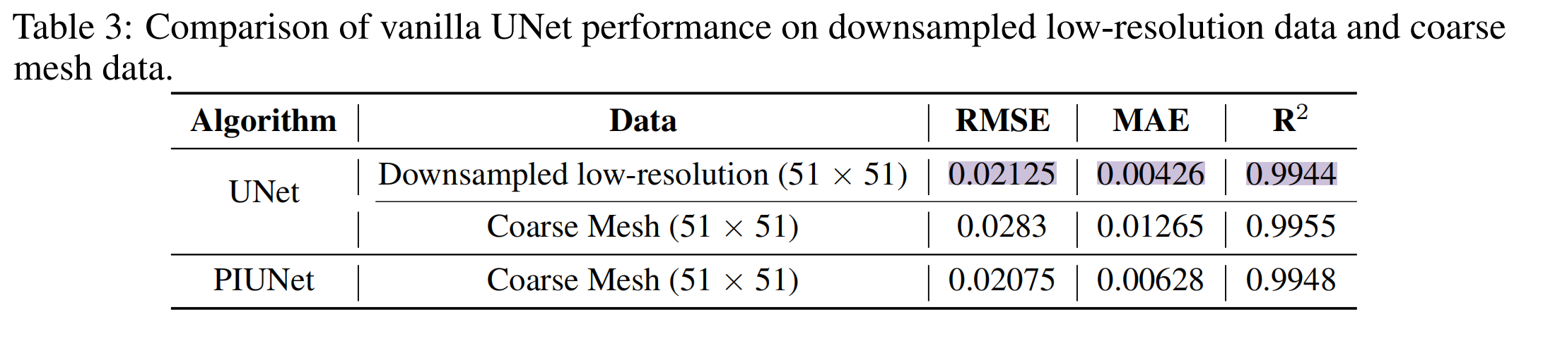
Comparative Analysis: Downsampling vs. Coarse Mesh Representation

Slide 16
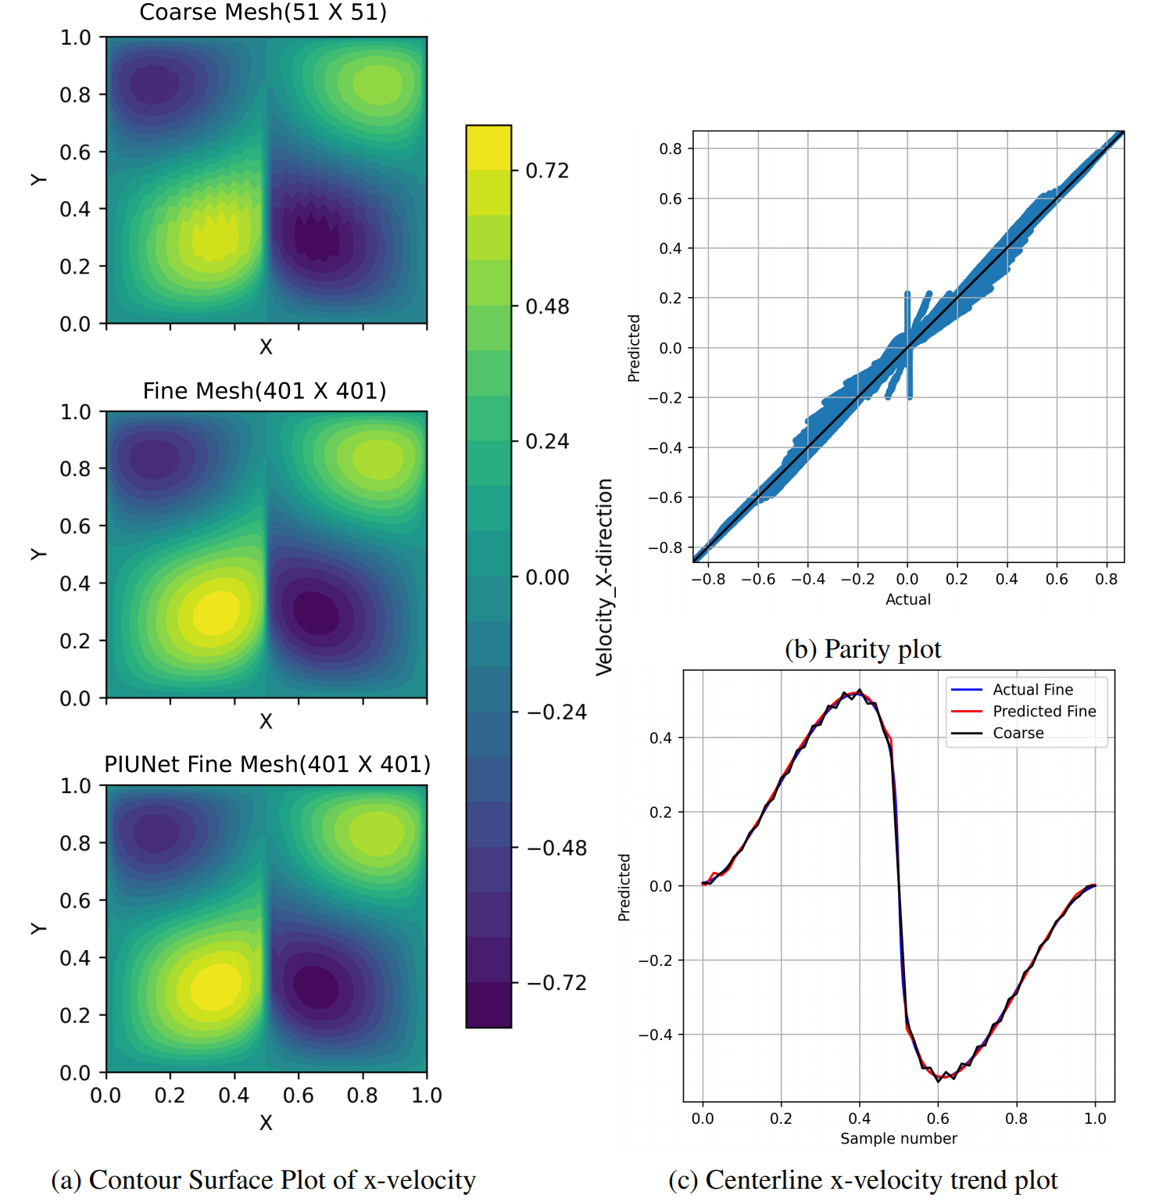
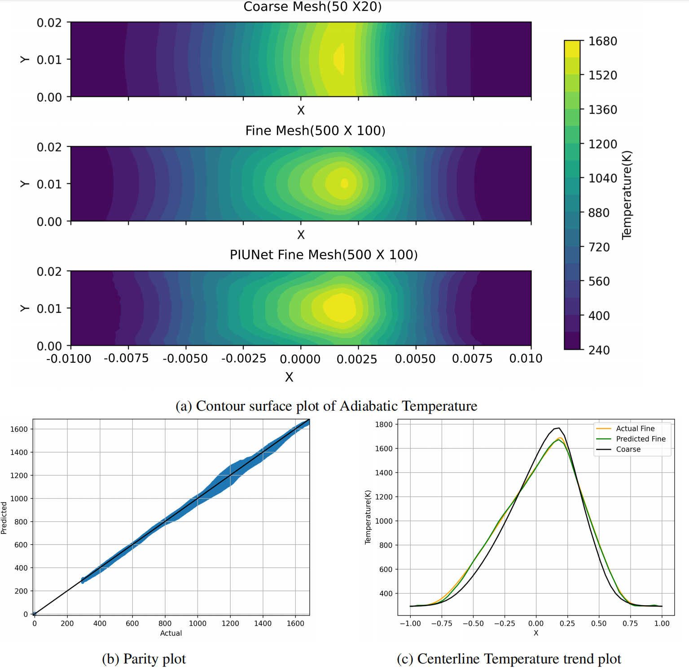
Performance

Slide 17
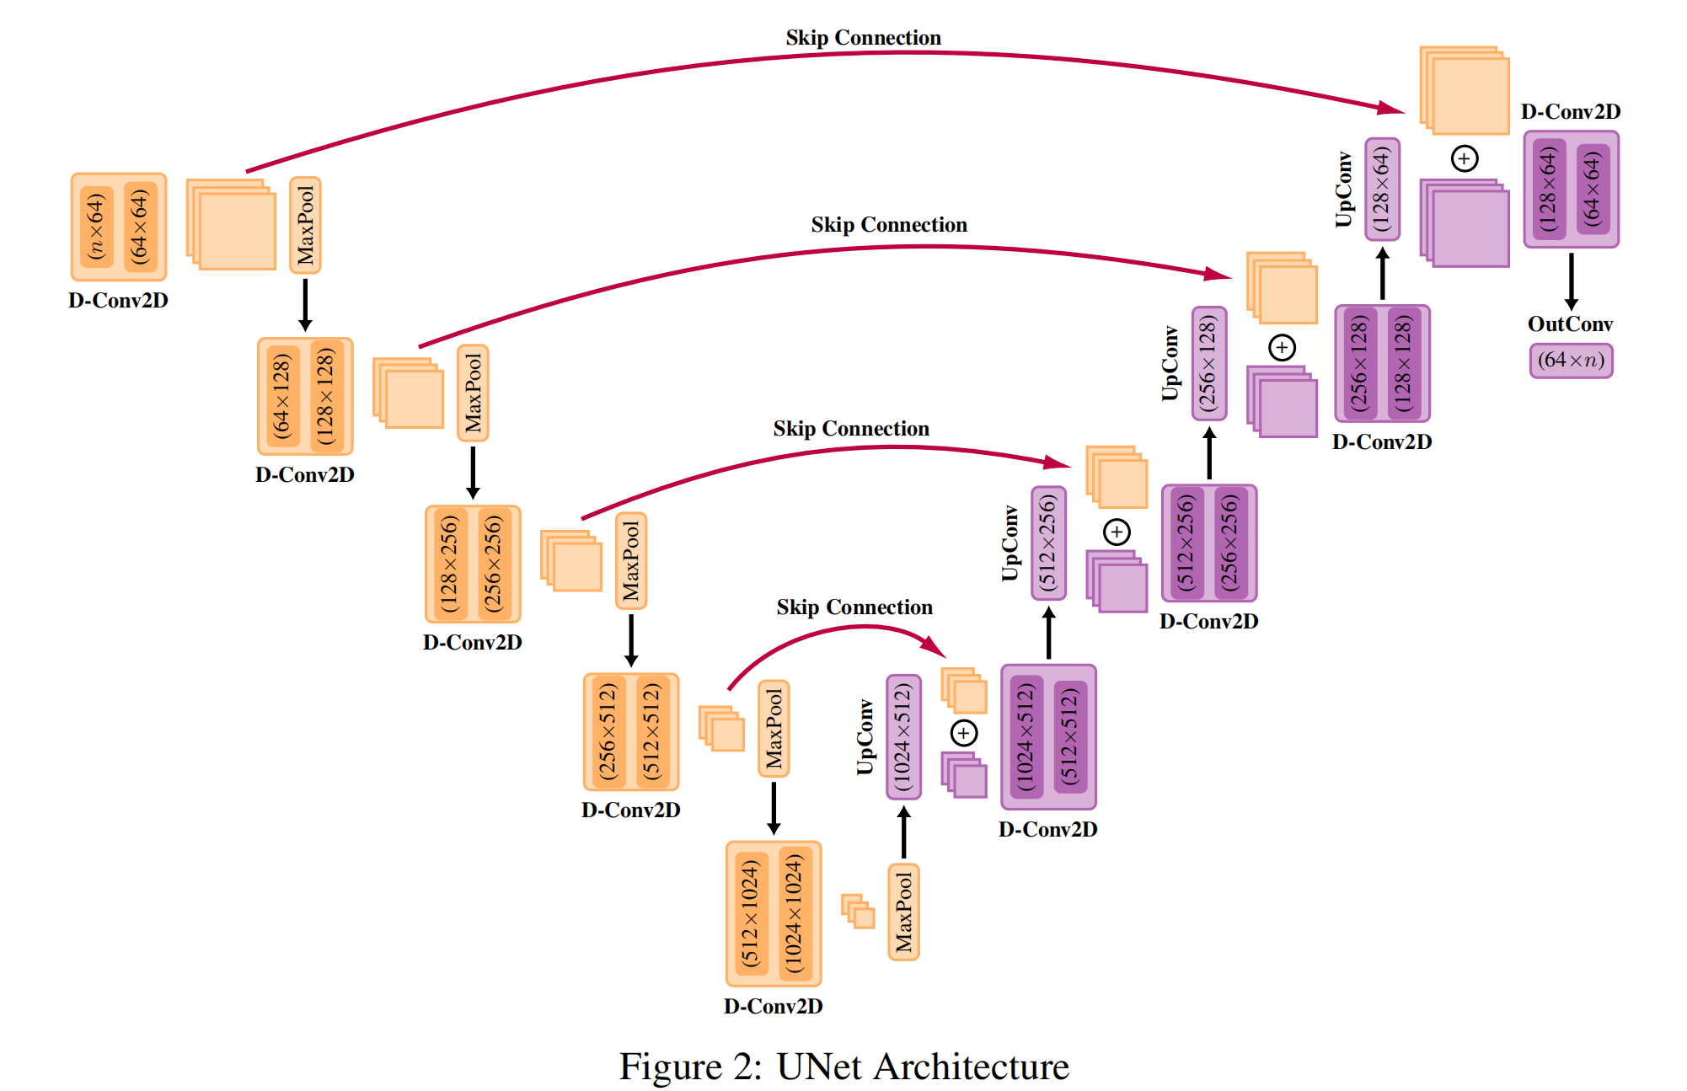
Pipeline

